Slide 1
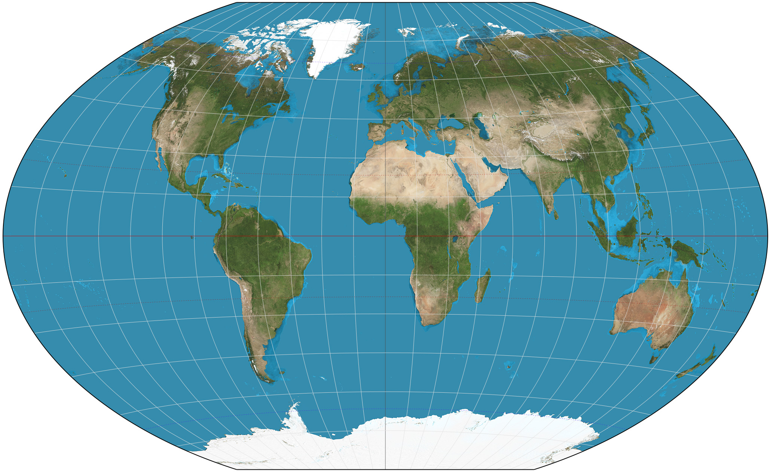
Rock and Roll outside the West
A Belated effort

Slide 2
Rock and Roll Dispersion
Hard to measure
Not a lot of research, and usually country specific
Spread quickly to Canada, Europe, Australia, New Zealand.
Slower to other countries, especially on the other side of the Iron Curtain.
But slipped in:
Ham radios
Tape recordings
X-rays records
Radio Free Europe
Black market

Slide 3
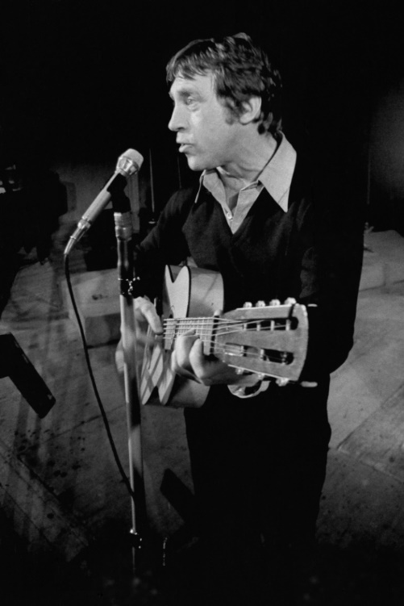
Popular Music on the other side
Vladimir Vysotsky, 1938-1980
Father: Jewish, Soviet Army Colonel, from Kiev Jews.
Mother: Russian, German language translator
After WWII, parents broke up.
Vlad lived with father and new Armenian wife, "Aunt Zhenya" in East Germany.
Vlad’s initial talent was in theatre.
1955, took one semester Moscow Institute of Civil Engineering, but then dropped out to become an actor.

Slide 4
Vladimir Vysotsky, 1938-1980
Initial career was in theatre and film
Began to write songs for both, and "for the drawer."
Film The Vertical, 1968, included his song "Song of a Friend" (Песня о друге).
https://www.youtube.com/watch?v=CZ5s4vdFhMA
Wrote thousands of songs, some never recorded.
Film Two Comrades were serving, 1968, led to most important and critical songs:
"Gypsy Variations" (Моя цыганская)
https://www.youtube.com/watch?v=-KdPhGBwkvE
Died of heart attack during the summer Olympics.

Slide 5
Plastic People of the Universe, 1968-1988
Czechoslovakia People’s Republic
1968: Prague Spring, Aleksandr Dubcek
August 1968: Warsaw Pact troops invaded.
Led to "Normalization".
September 1968: Bassist Milan Hlavsa formed Plastic People of the Universe.
Influenced by Frank Zappa ("Plastic People," 1967) and Velvet Underground.
Paul Wilson became their English singer and translator, 1970-1972.
1970: Czechoslovak government revoked their musicians’ licence.

Slide 6
Plastic People of the Universe, 1968-1988
Mostly a live band, performing where they could.
Banned from official performing, gathered underground cult following.
First album: Egon Bondy's Happy Hearts Club Banned (1974-1978)
https://www.youtube.com/watch?v=YXUIAqGFYNw
1976: The Plastics were arrested, tried, and convicted of "organized disturbance of the peace".
Sentenced to terms in prison from 8 to 18 months.
In response, Vaclav Havel wrote Charter 77: insisted government follow international agreements signed: Helsinki Accords.

Slide 7
Australia rocks
AC/DC
Formed in 1973 by Malcolm and Angus Young (born in Glasgow, Scotland).
Heavy Metal
First album, High Voltage, 1975:
"T.N.T": https://www.youtube.com/watch?v=X4RFEcR8z4Y&list=PL6QlhAaVb8s73JAfKDR-CYoSp1vlGaD2z&index=5
1979: Highway to Hell
1980: Bon Scott died; replaced by Brian Johnson
1980: Back in Black: Second highest?
"Hells Bells", "Shoot to Thrill", "You Shook Me All Night Long", and "Rock and Roll Ain't Noise Pollution"

Slide 8
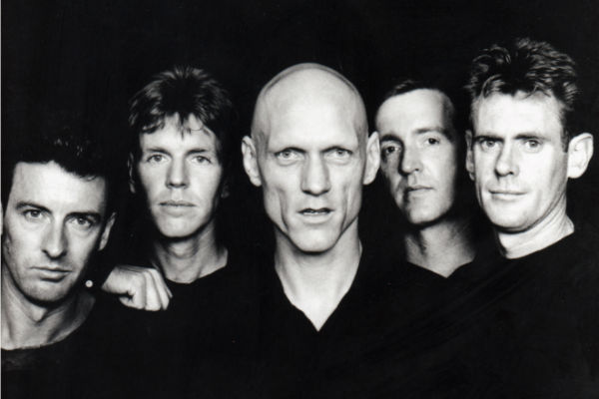
Midnight Oil, 1976-2002
Australian Rock (AC/DC, INXS, Hunters and Collectors, Crowded House)
Started as Farm in 1972:
Rob Hirst (drums)
Andrew James (bass guitar); replaced by Peter Gifford.
Jim Moginie (guitar, keyboards)
1975: Peter Garret (vocals)
1977: Martin Rotsey (guitars)
Hard rock
Incredible musicians
Complicated music, first Australian-focused band.
Political activism: anti-nuclear, aborigines’ rights, environmental movement

Slide 9
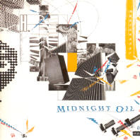
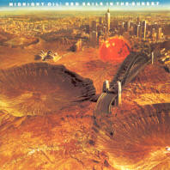
Midnight Oil, 1976-2002
First album: 10, 9, 8, 7, 6, 5, 4, 3, 2, 1 (1982)
https://www.youtube.com/watch?v=DELihw6CXpY&index=39&list=PL26011B9792301682
Second album: Red Sails in the Sunset (1984)
"Minutes to Midnight"
"Bells and Horns in the Back of Beyond"
https://www.youtube.com/watch?v=t0Nn70lSYzk
1987: Diesel and Dust: International recognition.

Slide 10
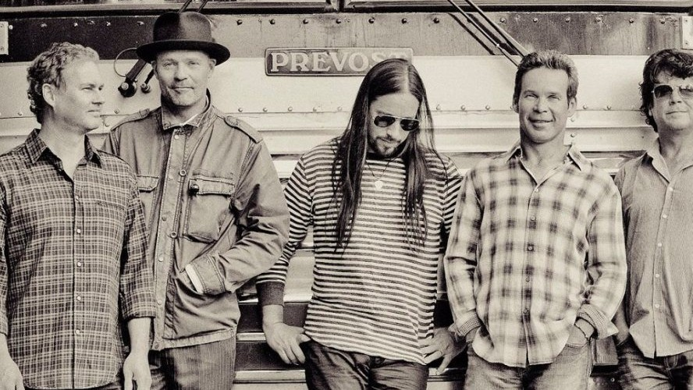
The Tragically Hip, 1984 to present
Canada
Gord Downie (vocals), February 6, 1964 – October 17, 2017
Paul Langlois (guitar)
Rob Baker (guitar)
Gord Sinclair (bass)
Johnny Fay (drums)
Formed in Kingston, Ontario

Slide 11
The Tragically Hip, 1984 to present
1986 first EP with MCA, "The Tragically Hip"
1989 first LP with MCA, "Up to here":
Singles: "Blow at High Dough", "New Orleans Is Sinking", "Boots or Hearts", and "38 Years Old"
1991: "Road Apples“
Singles: "Little Bones," "Twist My Arm," and "Three Pistols"
1992: “Fully Completely”
Centered on Canadian icons and history
Singles: "Locked in the Trunk of a Car", "Courage", and "At the Hundredth Meridian,” “Wheat Kings”
1993: Another Roadside Attraction Tour: Midnight Oil, Daniel Langlois, Hothouse Flowers, Crash Vegas

Slide 12
The Tragically Hip, 1984 to present
1994: “Day for Night”:
Singles: “Grace, Too,” “Nautical Disaster”
1995: appeared on SNL (thanks to Dan Aykroyd, who introduced them): https://www.youtube.com/watch?v=nOE8KeCbl_A
1996: “Trouble at the Henhouse”:
“Gift Shop”; “Ahead by a Century”
1998: “Phantom Power”:
"Bobcaygeon,” “Fire Works”, “Escape is at hand for the travellin’ man”
Last concert was broadcast live on CBC television.
Made Rock Music main stream in Canada (at least)

